Slide 1
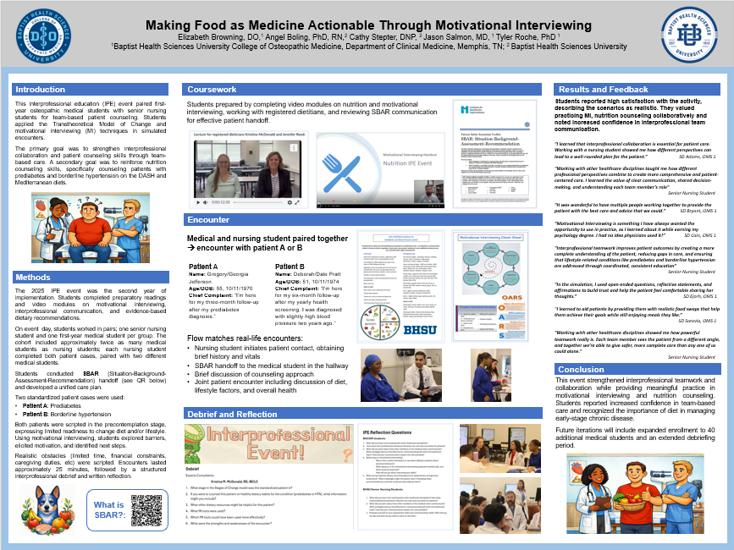
Making Food as Medicine Actionable
Through Motivational Interviewing
Interprofessional education event integrating osteopathic medical and senior nursing students
Elizabeth Browning, DO; Angel Boling, PhD, RN; Cathy Stepter, DNP, RN; Jason Salmon, MD; Tyler Roche, PhD
Baptist Health Sciences University | College of Osteopathic Medicine & College of Nursing
Poster-to-presentation conversion for IAMSE 2026
Notes:
Speaker notes:
Open by framing the project as a practical IPE activity designed to make nutrition counseling actionable through motivational interviewing and team-based patient interaction.
[Sources]
- Content adapted from the user-provided poster file: BUCOM IAMSE 2026 poster .pptx.

Slide 2
Why This Event?
A focused IPE activity for early team-based counseling practice
Educational Need
Primary Goal
Secondary Goal
First-year osteopathic medical students and senior nursing students need early, realistic practice in team communication and shared patient counseling.
Apply the Transtheoretical Model of Change and motivational interviewing techniques during simulated patient encounters.
Reinforce nutrition counseling related to DASH and Mediterranean diets for patients with prediabetes or borderline hypertension.
Notes:
Speaker notes:
Use this slide to establish the purpose of the activity and connect it to interprofessional education, behavior change, and food-as-medicine counseling.
[Sources]
- Content adapted from the user-provided poster file: BUCOM IAMSE 2026 poster .pptx.

Slide 3
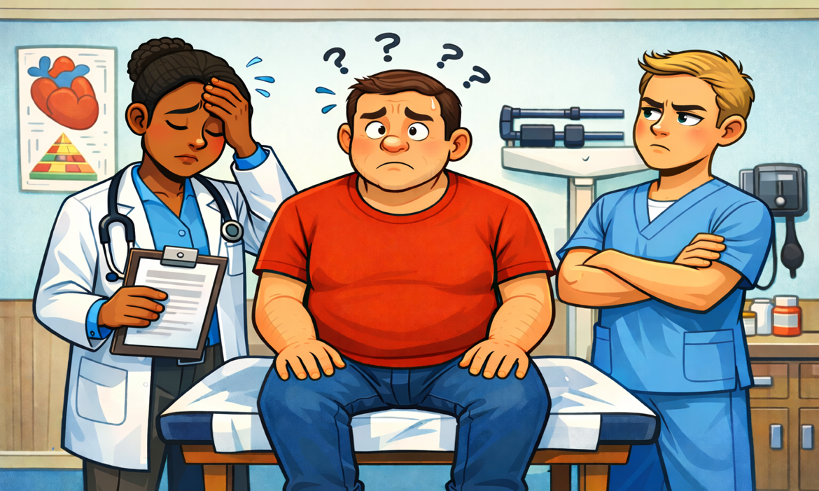

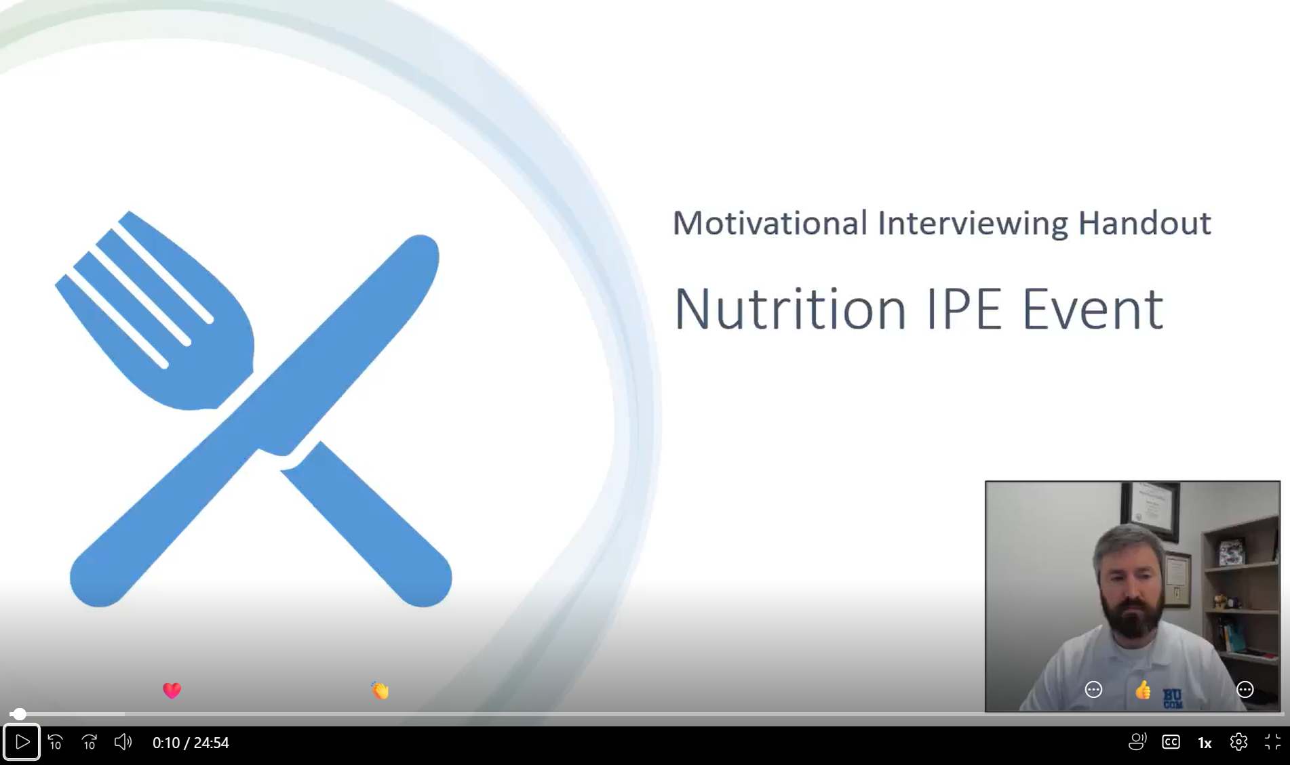

Student Preparation
Pre-work aligned team communication, motivational interviewing, and nutrition counseling
Preparatory learning
Readings and video modules on motivational interviewing
Interprofessional communication and SBAR handoff
Evidence-based dietary recommendations
Nutrition preparation with registered dieticians
Preparation emphasized practical skills students would immediately apply in the encounter.
Notes:
Speaker notes:
Emphasize that students were prepared before the simulation through readings, videos, nutrition content, motivational interviewing basics, and SBAR practice.
[Sources]
- Content adapted from the user-provided poster file: BUCOM IAMSE 2026 poster .pptx.

Slide 4
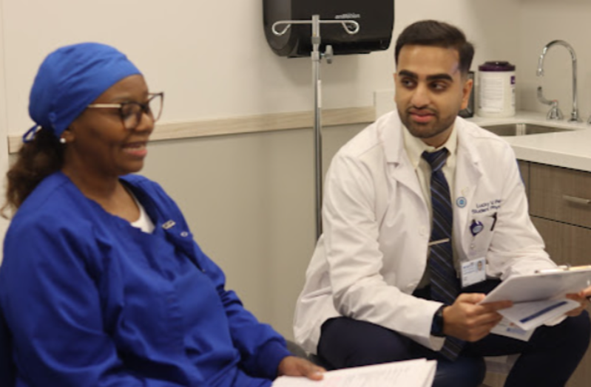
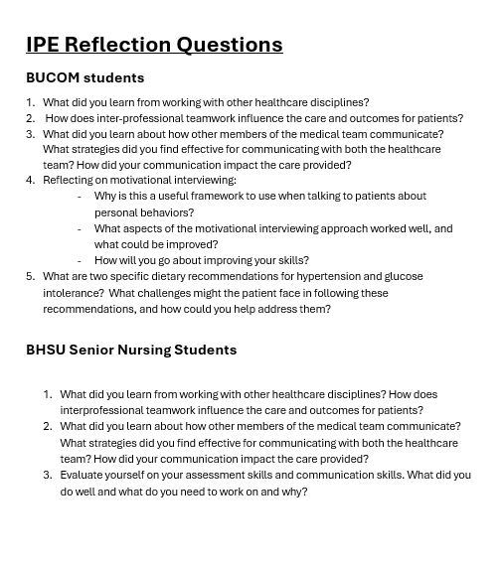
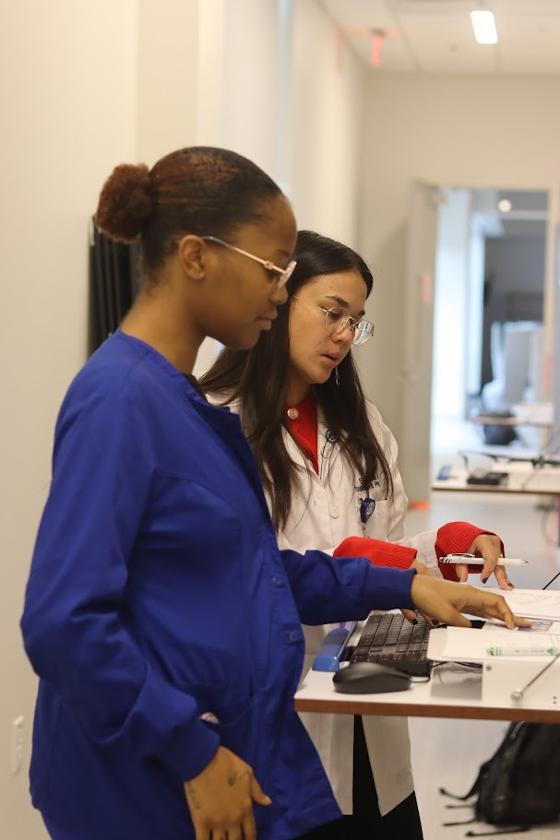
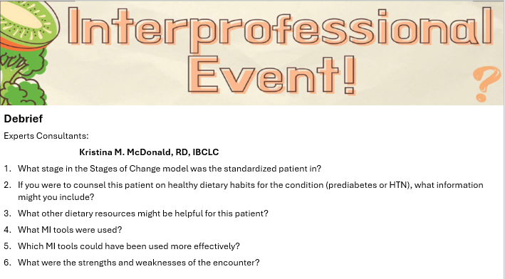
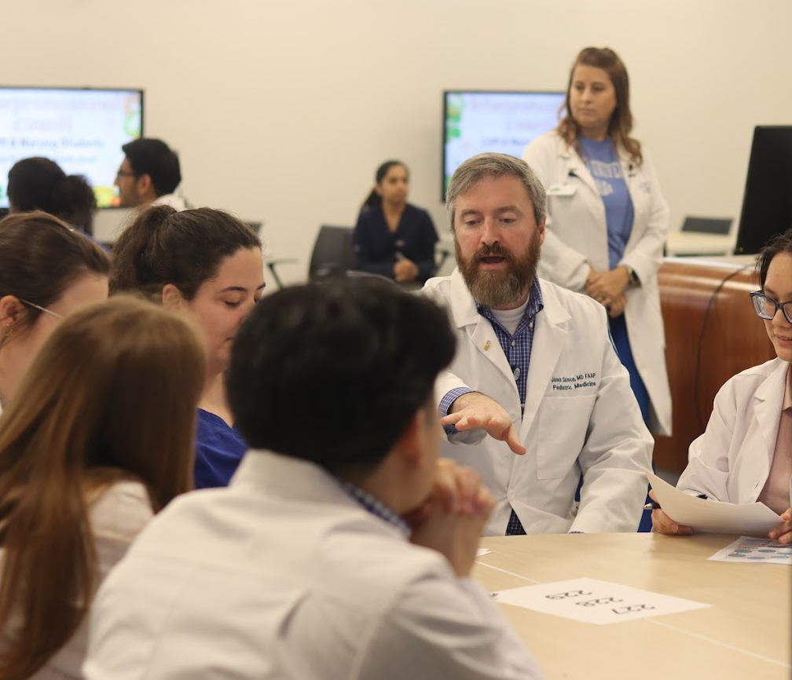

Simulation Design and Flow
The encounter mirrored a realistic handoff and collaborative counseling sequence
1
2
3
4
5
Nursing student enters first
SBAR handoff
Team planning
Joint counseling
Structured debrief
Gathers a brief history and vitals
Nursing student reports to the medical student
Pair briefly aligns on counseling approach
Both students counsel the patient on diet and health
Reflection follows the encounter
Notes:
Speaker notes:
Walk the audience through the sequence: history and vitals, SBAR, brief team planning, joint counseling, and debrief.
[Sources]
- Content adapted from the user-provided poster file: BUCOM IAMSE 2026 poster .pptx.

Slide 5
Standardized Patient Cases
Two scenarios began in the precontemplation stage
Case A: Prediabetes Follow-Up
Case B: Borderline Hypertension
Patient: Gregory/Georgia Jefferson
Age: 55
Chief complaint: three-month follow-up after prediabetes diagnosis
Counseling focus: realistic food swaps, readiness to change, and practical next steps.
Patient: Deborah/Dale Pratt
Age: 51
Chief complaint: six-month follow-up after yearly health screening and history of slightly high blood pressure
Counseling focus: DASH/Mediterranean diet concepts, barriers, and achievable changes.
Built-in barriers included limited time, financial constraints, and caregiving duties.
Notes:
Speaker notes:
Describe how each case was designed to require motivational interviewing rather than a simple information-delivery approach.
[Sources]
- Content adapted from the user-provided poster file: BUCOM IAMSE 2026 poster .pptx.

Slide 6
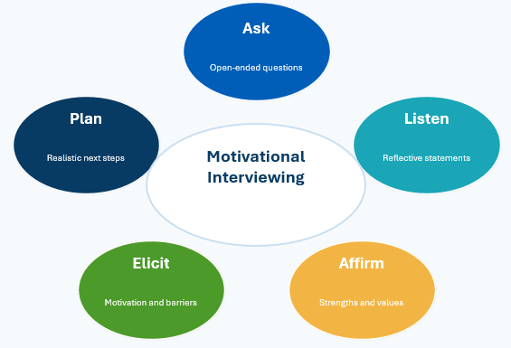
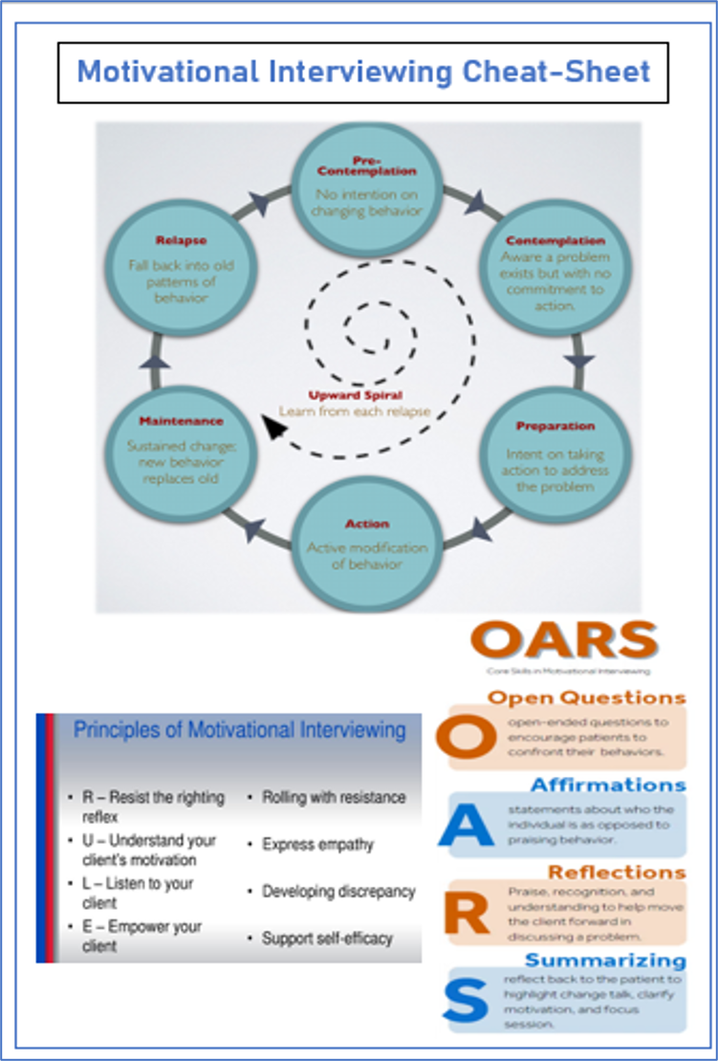
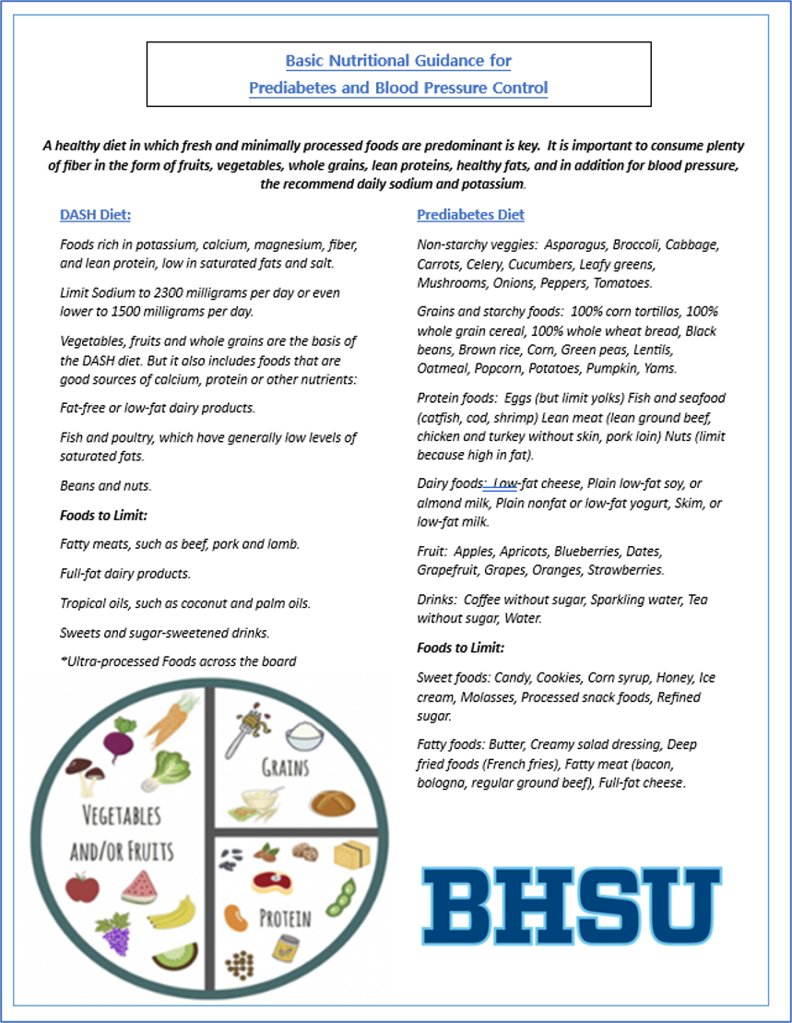
Counseling Framework
Students practiced behavior-change communication in a team setting
Patients were scripted with limited readiness to modify diet
Students explored barriers and readiness for change
Counseling connected dietary recommendations to patient goals
Handouts and cheat-sheets provided to support students during the encounter
Ask
Open-ended questions
Plan
Listen
Reflective statements
Elicit
Affirm
Motivation and barriers
Strengths and values
Goal: support progression from precontemplation toward contemplation or preparation.
Notes:
Speaker notes:
Connect the Transtheoretical Model and motivational interviewing techniques to the patient cases.
[Sources]
- Content adapted from the user-provided poster file: BUCOM IAMSE 2026 poster .pptx.

Slide 7
Student Voices
Reflection comments show perceived value of team-based counseling practice
“Interprofessional collaboration is essential for patient care.”
“Different perspectives can lead to a well-rounded plan.”
OMS 1
OMS 1
“Working with other healthcare disciplines showed me how powerful teamwork really is”
“I learned the value of clear communication, shared decision-making, and understanding each team member’s role”
Senior Nursing Student
Senior Nursing Student
“Realistic food swaps help patients achieve goals while still enjoying meals they like.”
SD Saravia, OMS 1
Notes:
Speaker notes:
Use a few selected student comments to illustrate collaboration, team communication, and practical application of motivational interviewing and nutrition counseling.
[Sources]
- Content adapted from the user-provided poster file: BUCOM IAMSE 2026 poster .pptx.

Slide 8
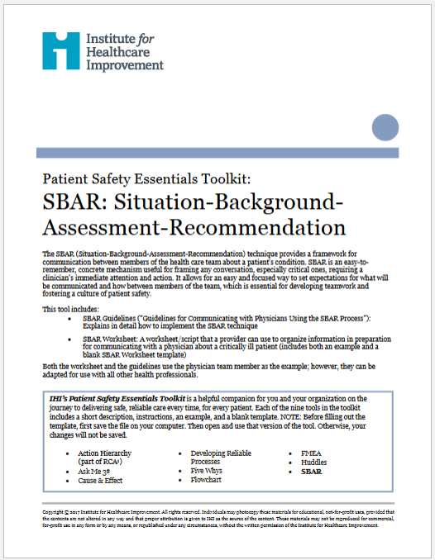

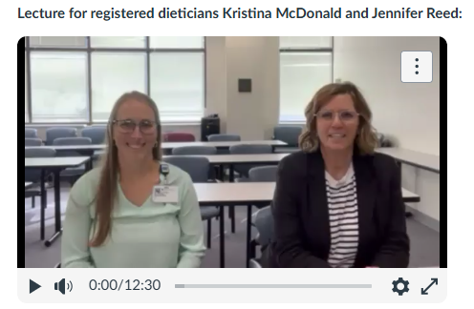
Results and Feedback
Students reported high satisfaction and increased confidence
High Satisfaction
Skill Practice
Confidence Building
Students described the scenarios as realistic and meaningful for practice.
Students valued applying motivational interviewing and nutrition counseling in a collaborative setting.
Students noted increased confidence in team communication and collaborative patient care.
Notes:
Speaker notes:
Summarize the reported response: satisfaction, realism, value of MI/nutrition practice, and confidence in communication.
[Sources]
- Content adapted from the user-provided poster file: BUCOM IAMSE 2026 poster .pptx.

Slide 9
Conclusion and Next Steps
The event strengthened interprofessional teamwork and practical patient counseling
Strengthened interprofessional teamwork through paired medical and nursing student encounters
Provided meaningful practice in motivational interviewing and nutrition counseling
Helped students recognize the role of diet in managing early-stage chronic disease
Future plans include adding 40 medical students and extending the debriefing period
Takeaway
Simulation can make “food as medicine” more actionable when students practice behavior-change counseling as an interprofessional team.
Use the debrief to deepen reflection, compare team roles, and connect counseling choices to patient readiness.
Notes:
Speaker notes:
Close with the educational significance and planned refinements. Emphasize that the activity provided practice in shared patient counseling and reflection.
[Sources]
- Content adapted from the user-provided poster file: BUCOM IAMSE 2026 poster .pptx.

Slide 10
References and Poster Source
Reference list transcribed from the original poster
References
• Loukas, M., Burns, D. Essential Ultrasound Anatomy. Wolters Kluwer Health. 2020.
• Thomas C, Nguyen P. “Sed Quia Non Numquam Eius Modi Tempora Incidunt Ulla Labore.” Healthcare Dynamics & Advances. 2022;15(9):58-73.
Note: This slide preserves the references as they appeared on the poster. Please verify final citation accuracy before conference submission.
Notes:
Speaker notes:
Use this as a backup or discussion slide if the audience asks to see the original poster layout. [Sources]
- Original poster image rendered from BUCOM IAMSE 2026 poster .pptx.
[Sources]
- Content adapted from the user-provided poster file: BUCOM IAMSE 2026 poster .pptx.

